Slide 1
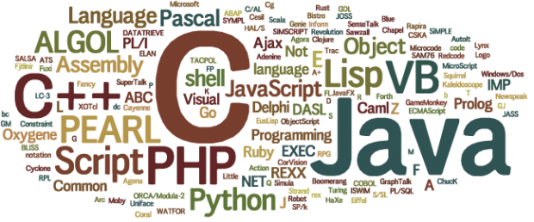
CSE101 Intro to CS and Programming
Introduction to Programming Languages
Week 10 Lectures
By Mr. Faheem Shaukat
faheem@iqraisb.edu.pk
Github.com/faheemshaukat

Slide 2
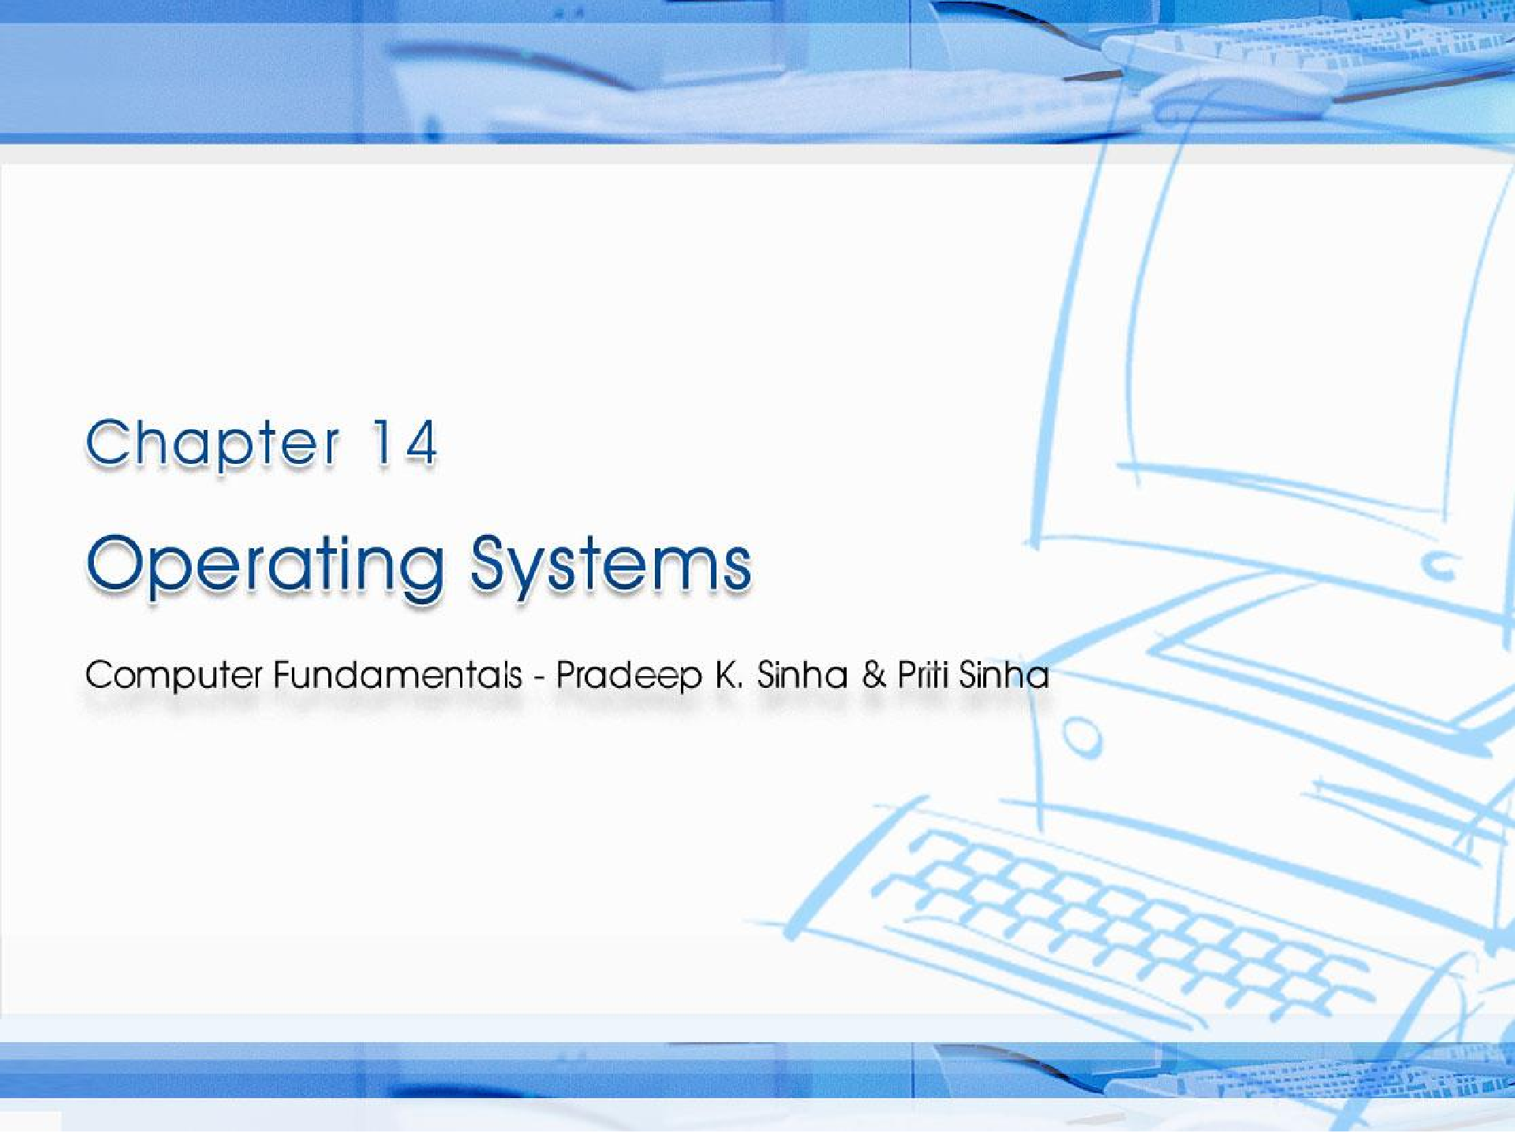
CCoommppuutterer FFununddaammenenttaallss:: PPrradadeeeepp KK.. SSiinhnhaa && PPrriititi SSiinhanha
Chapter 14 Operating Systems
Ref Page Chapter 14: Operating Systems Slide 1/54

Slide 3

Learning Objectives
Computer Fundamentals: Pradeep K. Sinha & Priti Sinha
In this chapter you will learn about:
Definition and need for operating system
Main functions of an operating system
Os Architecture
251
Slide 3/54

Slide 4
Definition and Need for OS
Computer Fundamentals: Pradeep K. Sinha & Priti Sinha
Integrated set of programs that controls the resources (the CPU, memory, I/O devices, etc.) of a computer system
Provides its users with an interface or virtual machine that is more convenient to use than the bare machine
Two primary objectives of an OS are:
Making a computer system convenient to use
Managing the resources of a computer system
251
Slide 4/54

Slide 5

Lo gical Architecture of a Computer System
Computer Fundamentals: Pradeep K. Sinha & Priti Sinha
Users
Other System Software and Application Programs
Operating System
The operating system layer hides the details of
Computer Hardware
the hardware from the programmer and provides the programmer
with convenient interface for using the system
252
Slide 5/54

Slide 6
Main Functions of an OS
Computer Fundamentals: Pradeep K. Sinha & Priti Sinha
Process management
Memory management
File management
Security
Command interpretation
252
Slide 6/54

Slide 7
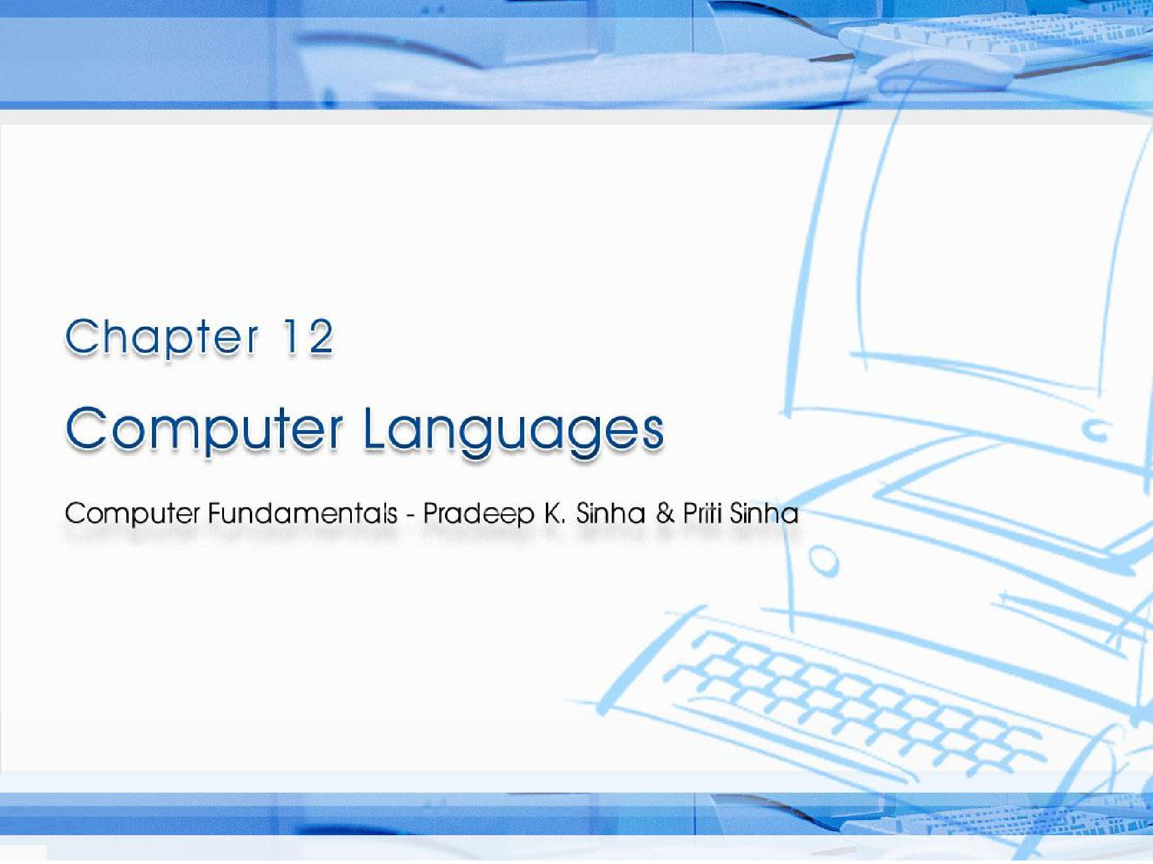
CCoommppuutterer FFununddaammenenttaallss:: PPrradadeeeepp KK.. SSiinhnhaa && PPrriititi SSiinhanha
Ref Page Chapter 12: Computer Languages Slide 1/59

Slide 8
Learning Objectives
Computer Fundamentals: Pradeep K. Sinha & Priti Sinha
In this chapter you will learn about:
Computer languages or programming languages
Three broad categories of programming languages – machine, assembly, and high-level languages
Commonly used programming language tools such as assembler, compiler, linker, and interpreter
Bug and Debug
208
Slide 2/59

Slide 9
Program and Programming Languages
A well-defined set of instruction given to the computer is called Computer Program.
A set of words and symbols used to write programs is called programming language.
The programming language are used to write computer programs.

Slide 10
Broad Classification of Computer Languages
Computer Fundamentals: Pradeep K. Sinha & Priti Sinha
Low Level Languages
High Level Languages
209
Slide 3/59

Slide 11
Low Level Languages
Low level language are near to computer and far from human languages.
Its in the form of binary codes.
Sub Divided into following
Machine Language
Assembly Language

Slide 12
Machine Language
Computer Fundamentals: Pradeep K. Sinha & Priti Sinha
A type of language in which instructions are written in binary form is called machine language.
The Program written in machine language can be execute fast by computer but it is machine dependent.
It is the only language that is directly understand by computer
209
Slide 4/59

Slide 13
A Sample Machine Language Program
Computer Fundamentals: Pradeep K. Sinha & Priti Sinha
001000000000001100111001 | 10001471
001100000000010000100001 | 14002041
011000000000011100101110 | 30003456
101000111111011100101110 | 50773456
000000000000000000000000 | 00000000
In Binary | In Decimal
(Difficult to read and understand) | (Easier to read and understand)
210
Slide 13/59

Slide 14
Advantages & Limitations of Machine Language
Computer Fundamentals: Pradeep K. Sinha & Priti Sinha
Advantage
Can be executed very fast
Limitations
Machine Dependent
Difficult to program
Difficult to modify
210
Slide 14/59

Slide 15
Assembly language
It is one step higher then machine language.
In assembly language machine instructions are replaced with English like codes.
The translator called assembler is used to convert assembly language program into machine language.

Slide 16
An Example of Assembly Language Program
Computer Fundamentals: Pradeep K. Sinha & Priti Sinha
Mnemonic | Opcode | Meaning
HLT | 00 | Halt, used at the end of program to stop
CLA | 10 | Clear and add into A register
ADD | 14 | Add to the contents of A register
SUB | 15 | Subtract from the contents of A register
STA | 30 | Store A register
A subset of the set of instructions supported by a computer
213

Slide 17
Advantages of Assembly Language Over Machine Language
Computer Fundamentals: Pradeep K. Sinha & Priti Sinha
Easier to understand and use
Easier to locate and correct errors
Easier to modify
No worry about addresses
Easily relocatable
Efficiency of machine language
214

Slide 18
High-Level Languages
Computer Fundamentals: Pradeep K. Sinha & Priti Sinha
Machine independent
A type of language that is close to human language is called high level language.
Do not require programmers to know anything about the internal structure of computer on which high-level language programs will be executed
Every high level language define set of rules called syntax.
Language translator convert high level code to low level and it also detect syntax error.
If there is Syntax error then program cant be convert by translator.
216

Slide 19
Characteristics of high level language
Easy to learn
Easy Error detection
Standardize Syntax
Machine Independent
Shorter Program

Slide 20
What is Source Code and Object Code
Source Code:
A program written in a high level language is called source code.
The source code cannot be executed by computer directly.
Object Code:
A program in machine language is called object code. It is also called object program or machine code.
Computer understand object code directly.

Slide 21
Assembler
Computer Fundamentals: Pradeep K. Sinha & Priti Sinha
Software that translates as assembly language program into an equivalent machine language program of a computer
Assembly language program
Input
Assembler
Output
Machine language program
One-to-one correspondence
(Source Program)
(Object Program)
212
Slide 21/59

Slide 22
Compiler
Computer Fundamentals: Pradeep K. Sinha & Priti Sinha
Translator program (software) that translates a high- level language program into its equivalent machine language program as a whole.
Compiles a set of machine language instructions for every program instruction in a high-level language
High-level language program
Input
Compiler
Output
Machine language program
(Source Program)
One-to-many correspondence
(Object Program)
217

Slide 23
Interpreter
Computer Fundamentals: Pradeep K. Sinha & Priti Sinha
Interpreter is a high-level language translator
An interpreter is a program that converts one statement of a program into machine at one time.
Takes one statement of a high-level language program, translates it into machine language instructions
220

Slide 24
Intermediate Language Compiler & Interpreter
Computer Fundamentals: Pradeep K. Sinha & Priti Sinha
New type of compiler and interpreter combines the speed, ease, and control of both compiler and interpreter
Compiler first compiles the source program to an
intermediate object program
Intermediate object program is not a machine language code but written in an intermediate language that is virtually machine independent
221

Slide 25
Linker and Pre-Proceessor directives
Linker
A program that combine the object program with additional library files is known as linker.
It is a part of c++ compiler.
A new file is created with .exe if the process of linking is successful.
Pre-Processor directives
Is an instruction given to the compiler before the execution of actual program.
Also known as compiler directives its is the part of compiler.
Header File are collection of standard library functions to perform different tasks.

Slide 26
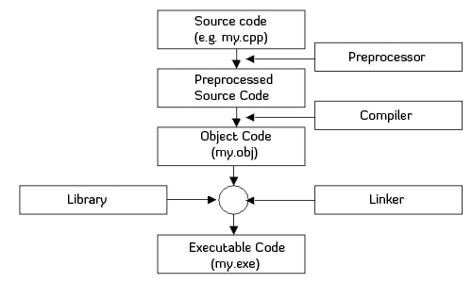
C++ Compiling and Linking Process

Slide 27
Bug and Debug
Bug
An error in a computer is known as bug.
Debugging
The errors must be removed from the program before it can be compiled and executed. The process of finding and removing bugs is known as debugging.

Slide 28
Types of Error
Computer Fundamentals: Pradeep K. Sinha & Priti Sinha
Syntax error
syntax error is a type of error that occurs when an invalid statement is written in program.
Logical error
A type of error that occurs due to poor logic of the programmer is called logical error. A statement with logical error may produce unexpected and wrong results in the program.
Run time error
A type of error that occurs during the execution of the program is known as runtime error. It occurs when a statement directs the computer to execute an illegal operation such as dividing a number by zero.
219

Slide 29
The Process of Removing Syntax Errors From A Source Program
Computer Fundamentals: Pradeep K. Sinha & Priti Sinha
START
Edit source program
Source program Compile
source program
Syntax errors detected?
Yes
No
Generate object program
Object program
STOP
Generate list of coded
error messages
219

Slide 30
C++
Computer Fundamentals: Pradeep K. Sinha & Priti Sinha
Named C++ as ++ is increment operator and C language is incremented to its next level with C++
Developed at Bell Labs in the early 1980s
Contains all elements of the basic C language
Expanded to include numerous object-oriented programming features
Provides a collection of predefined classes, along with the capability of user-defined classes
229

Slide 31
Terms in Programming Development
Unstructured programming language
The entire logic of the program is implemented in a single module or function.
Structure programming language
The entire logic of the program is divided into a number of smaller modules or functions.

Slide 32
Characteristics of a Good Programming Language
Computer Fundamentals: Pradeep K. Sinha & Priti Sinha
Simplicity
Naturalness
Efficiency
Structured Programming Support
Compactness
Locality
Extensibility
Suitability to its environment
233

